Slide 1

Business Data
Management
IIT Madras
BS degree
Capstone Project
Optimizing Sales of a B2B garment shop
Ritik Ranjan
21f2001147
21f2001147@ds.study.iitm.ac.in

Slide 2

Introduction & Objectives
Objectives:
Increasing revenue of the 2nd quarter of the financial year which has the lowest sales .
Increasing the inventory capacity so as to generate maximum profit during the high sales winter months.
Outdated readymade garments in some categories are contributing to low sales in some financial quarters .
Increasing the overall profitability of the business and facing the e - commerce.
1

Slide 3
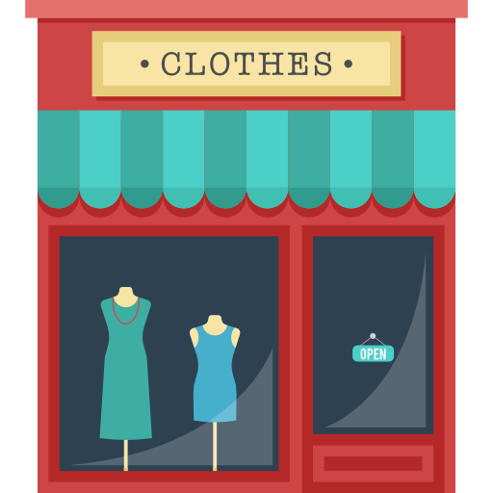
Company’s Background
About Shop:
Savitry Handloom is a B2B readymade garment shop located in Sikandra , Bihar.
It is selling its products since 2016 and has earned a good reputation in the market.
Its main area of business includes parts of jamui, kaindi , patna city , aliganj bazar , sharma market/sikandra and nawada.
Employees:
It currently has about 8 employees
Salary range - 20k to 40k
Problems faced by the shop:
Low sales during the summer season i.e. mainly during the 2nd and 3rd financial year.
Small storage capacity
Many outdated collection of garments which they are unable to sell
Supply chain management needs to be improved.
Digital inventory management is not present.

Slide 4
Analysis Method
Analysis of the sales data of one financial year.
Pivot tables and other excel tools will be utilized to identify trends.
Month wise and financial quarter wise analysis is done .
Highest and lowest revenue generating quarters were identified.
Volume wise analysis of each product was done.
Volume Vs Revenue of each product was done and based on that identification of top and bottom 20 products.
Total revenue generated in one financial year from each consignee was analyzed.
Outdated products were identified and strategies to sell them is discussed.

Slide 5
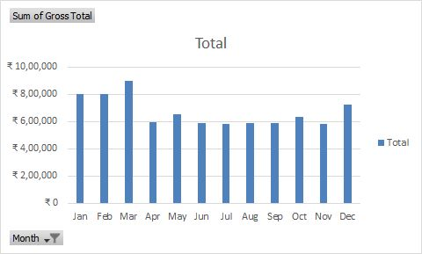
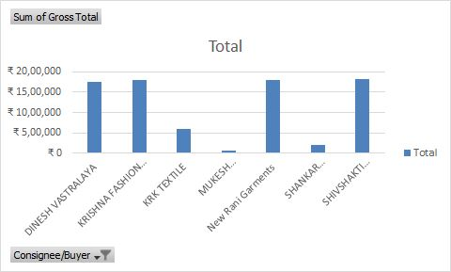
Revenue Analysis
The above analysis shows that December , January , February and March are the highest revenue generating months, with March being the highest.
Dinesh vastralaya , Krishna fashion world , New rani garments and shivshakti handloom are the major consignees. 80% of the revenue comes from these 4 consignees only.

Slide 6
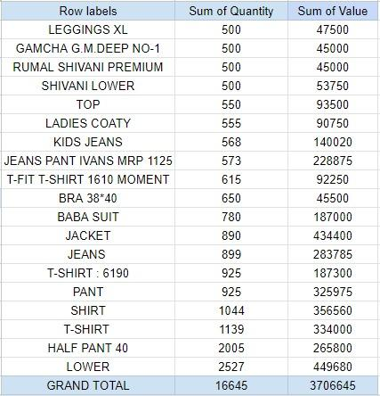
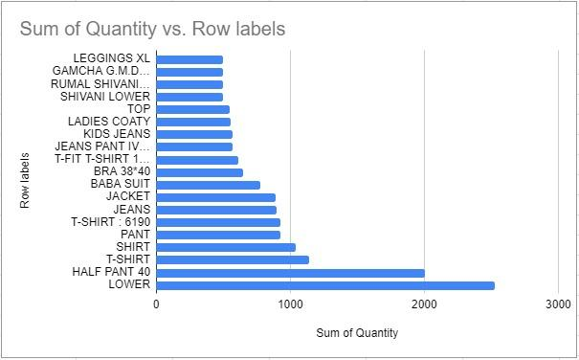
Revenue Vs Volume Analysis
From the above pivot table we can observe that some products like Ivans Jeans, Jackets , shirts generate high value even when in low quantity. By comparing the above sum of quantity sold to the sum of quantity in inventory, it can be determined which products are overstocked or understocked and adjust inventory levels accordingly.

Slide 7
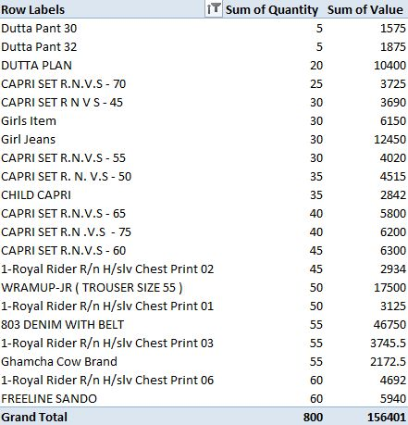
Analysis of Underperforming products
From the pivot table we can analyse the top 20 underperforming products which are not generating much revenue.
These products can be made profitable with the help of price adjustment , if the price is high we can offer some discounts to create demand.
With the help of advertisements and lucrative discounts also we can clear these inventories so as to make some space for new profitable inventories.

Slide 8
Recommendations:
Recommendation 1 : Increasing revenue of the 2nd quarter of the financial year which has the lowest sales .
The major factors which were contributing to the low revenue in the 2nd quarter were outdated garment categories , price of these categories was also too high due to which many consignees were not purchasing them.
I suggested some strategies to cope up with this problem such as , clearing these outdated categories inventory by offering some discounts .
Recommendation 2 : Increasing the inventory capacity so as to generate maximum profit during the high sales winter months.
Due to the low inventory capacity the business is failing to generate the maximum output from these quarters. If the inventory size would have been large , then the shop can store more quantities of these products.
To solve this problem the owner can lease out temporary storage warehouses for these 2 quarters. Where he can store surplus quantities.

Slide 9
Recommendations:
Recommendation 3 : Outdated readymade garments in some categories are contributing to low sales in some financial quarters .
It was recommended to conduct a market research to identify which categories of readymade garments are selling well and which ones are not. This can help the business to focus on stocking items that are in demand, rather than those that are not.
Introducing new product lines that are more in line with current fashion trends or customer preferences. This can help to attract new customers and increase sales overall.
Recommendation 4 : Increasing the overall profitability of the business and facing the e - commerce.
I found out that the business is also facing stiff competition from Big brands like AJIO, Myntra etc. which are attracting a lot of their customers and day by day it’s becoming difficult for them to survive.
I suggested some solutions for the above problem which includes offering unique products or services that customers cannot find online.

Slide 10




Conclusion
Analyzing sales data of whole financial year has led us to several recommendations to optimize the overall revenue of the shop.
Strategies like giving discounts on outdated products and increasing the inventory of new products , increasing the overall storage capacity, searching for new consignees and adopting digital management systems etc. were discussed.
The recommendations and strategies have the potential to increase the overall revenue for the shop and optimize the overall business.
The link of the sales data of the shop is as follows: Sales_Data.xlsx

